Slide 1
Business Applications
Dynamics 365 and Power Platform: Sales, Customer Service and Marketing Apps

Slide 2

Agenda
Dynamics 365 and Power Platform: Sales, Customer Service, and Marketing Apps
Whiteboard Design Session: Designing a solution to integrate with customer’s existing cloud investments and Dynamics 365
Team Challenge: Delivering an integrated solution on the Power Platform using Sales, Customer Service and/or Marketing solutions

Slide 3
Daily Rundown
Timeframe | Activity | Engagement
8:00 – 8:45 | D365 Sales, Customer Service, and Marketing Apps | Interactive Discussion
9:00 – 11:00 | Whiteboard Design Session
11:00 – 12:00 | Long Break
12:00 – 2:00 | Team Challenge | Hands On: Group Work
2:00 – 2:15 | Wrap Up (Office Hours)

Slide 4
Dynamics Apps

Slide 5
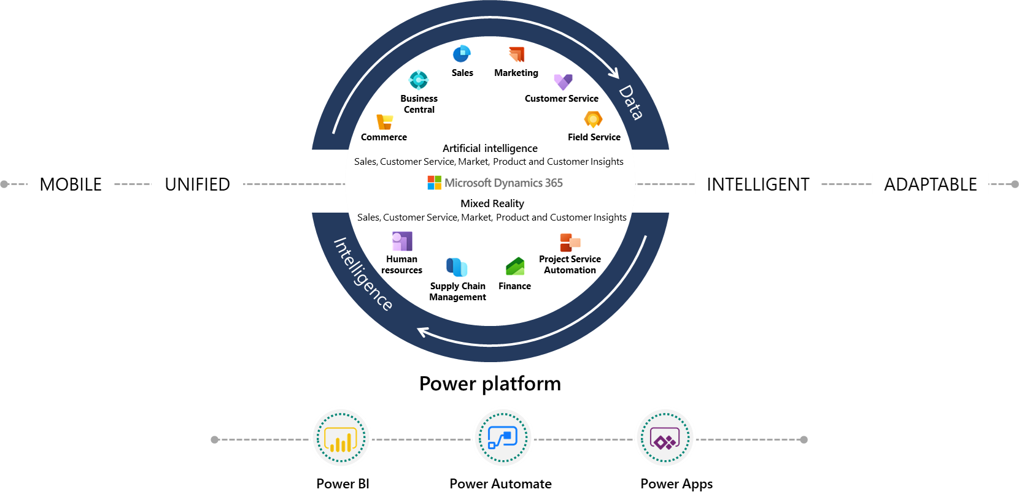
Overview of Dynamics 365 Business Applications
Notes:
Dynamics 365 is a family of business applications covering a wide range of business areas.

Slide 6
Why Microsoft Business Applications?
Adaptable to match companies' business requirements
Extendable to tailor each specific company’s needs
Integrated with Microsoft Power Platform and 3rd party applications from AppSource
Notes:
Dynamics 365 Business Applications are:

Slide 7
Customer Engagement apps
Sales
Marketing
Customer Service
Field Service

Slide 8
Dynamics 365 Sales
Actionable insight
Customer
Sales performance
Seller
Personal engagement
Customer management
Manager
Notes:
Today, the process of engaging customers can't be one-size-fits-all. It needs to be adaptive across all touch points and within the context of who your customer is and what they are doing. Microsoft Dynamics enables your company to build customer trust, loyalty, and insight, while also enabling your sales, service, and marketing professionals to be as productive as possible. With Dynamics 365, we help your company deliver exceptional customer experiences.

Slide 9
Dynamics 365 Customer Service
Virtual Agents
Service recommendation
Omnichannel engagement:
Personalized service across channels
Unified routing & work distribution
Agent productivity:
Unified, contextual experience
Remote assist
CUSTOMER
EMPLOYEE
Proactive service:
Remote device commanding
Proactive insights
Insights & AI:
Performance & trends across channels
Agent performance & utilization
Notes:
Elaborate on the five core areas that customer service organizations should invest in, in order to stay relevant and competitive in the changing customer service landscape.

Slide 10
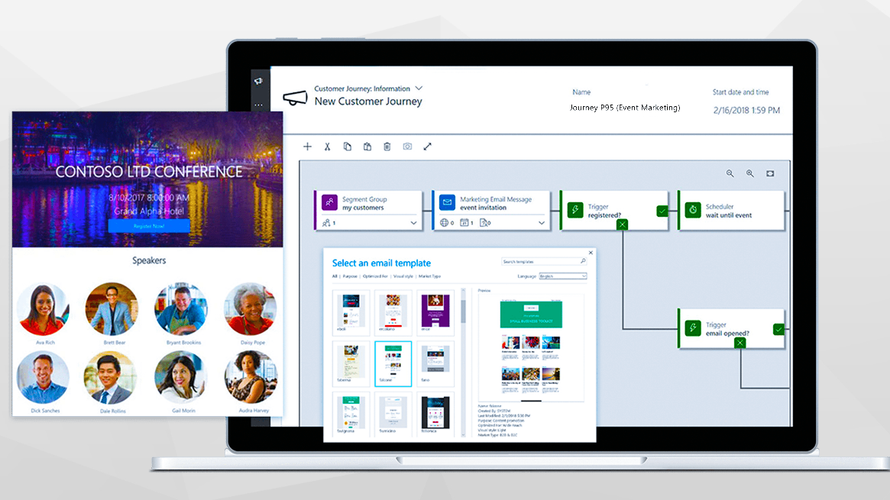
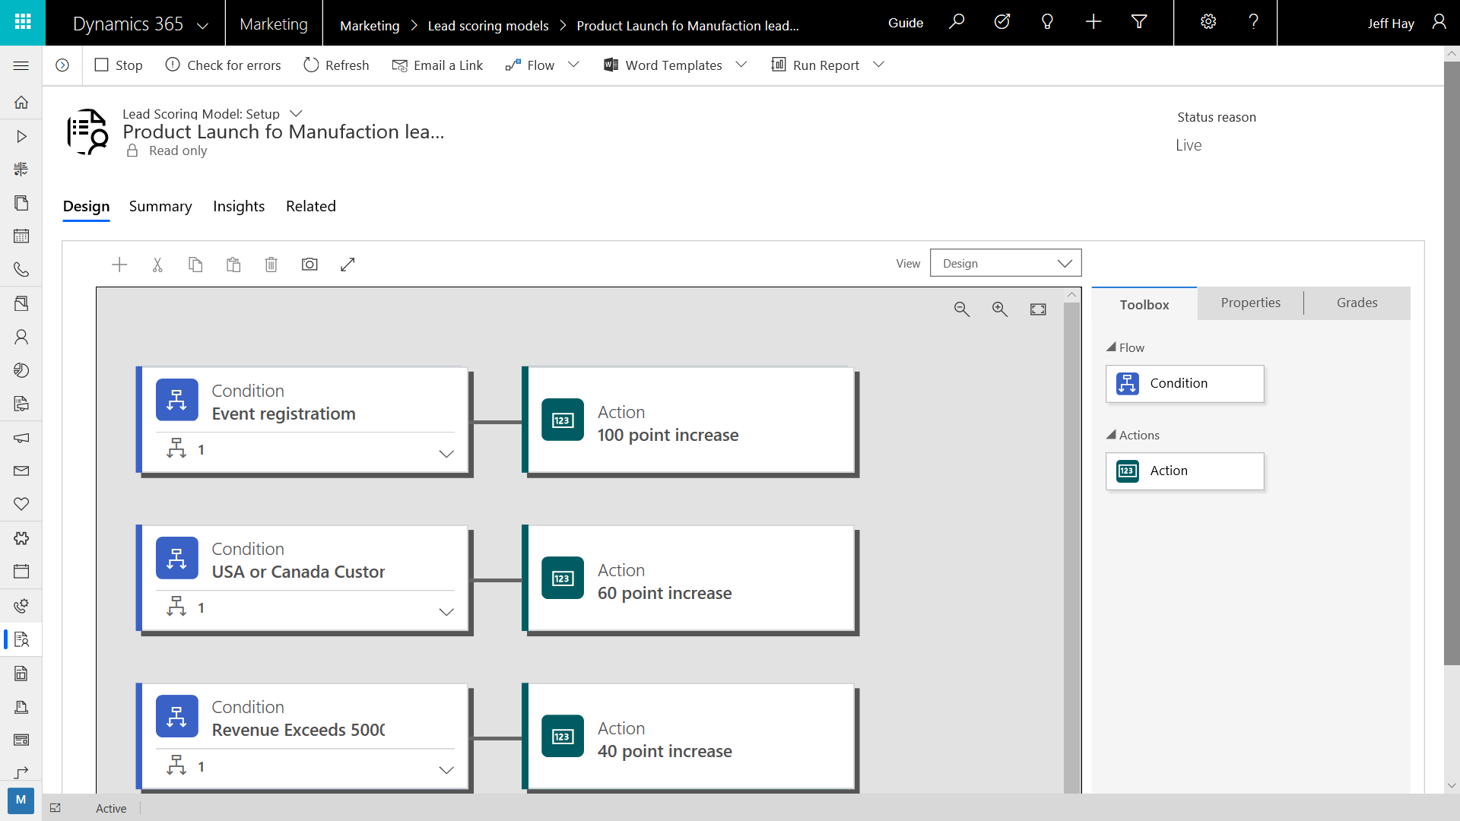
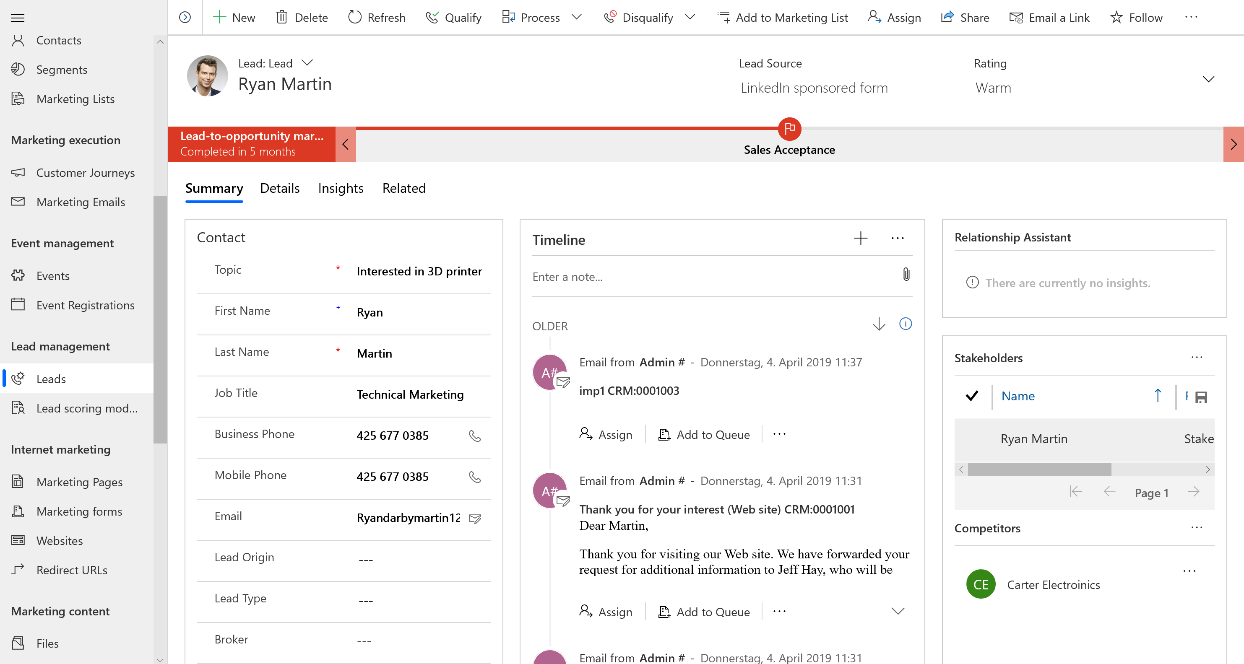
Dynamics 365 Marketing
Generate leads across
multiple channels
Nurture and prioritize leads
Deliver sales-ready leads
with insights
Notes:
It helps you to create and nurture and prioritize leads, by running targeted, multi-channel campaigns and personalize each buyer’s journey to generate more sales-ready leads.

Slide 11
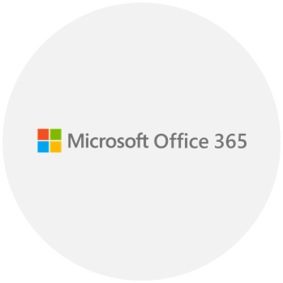
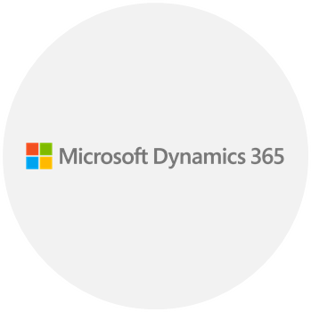
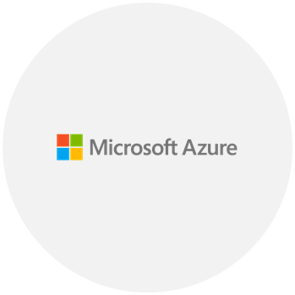
Platform components
Microsoft Cloud
Security
GDPR
Connect to, import, export and analyze data
Integration with Office 365, Email, Word, and Excel
Notes:
GDPR

Slide 12
Demo

Slide 13
Discussion Point
Your client is looking to nurture leads into opportunities that the sales team will interact with. What app should you recommend?
Your client needs to be able to record their relationship with their accounts, including issues that pop up after the initial sales period. What solution would you recommend?

Slide 14
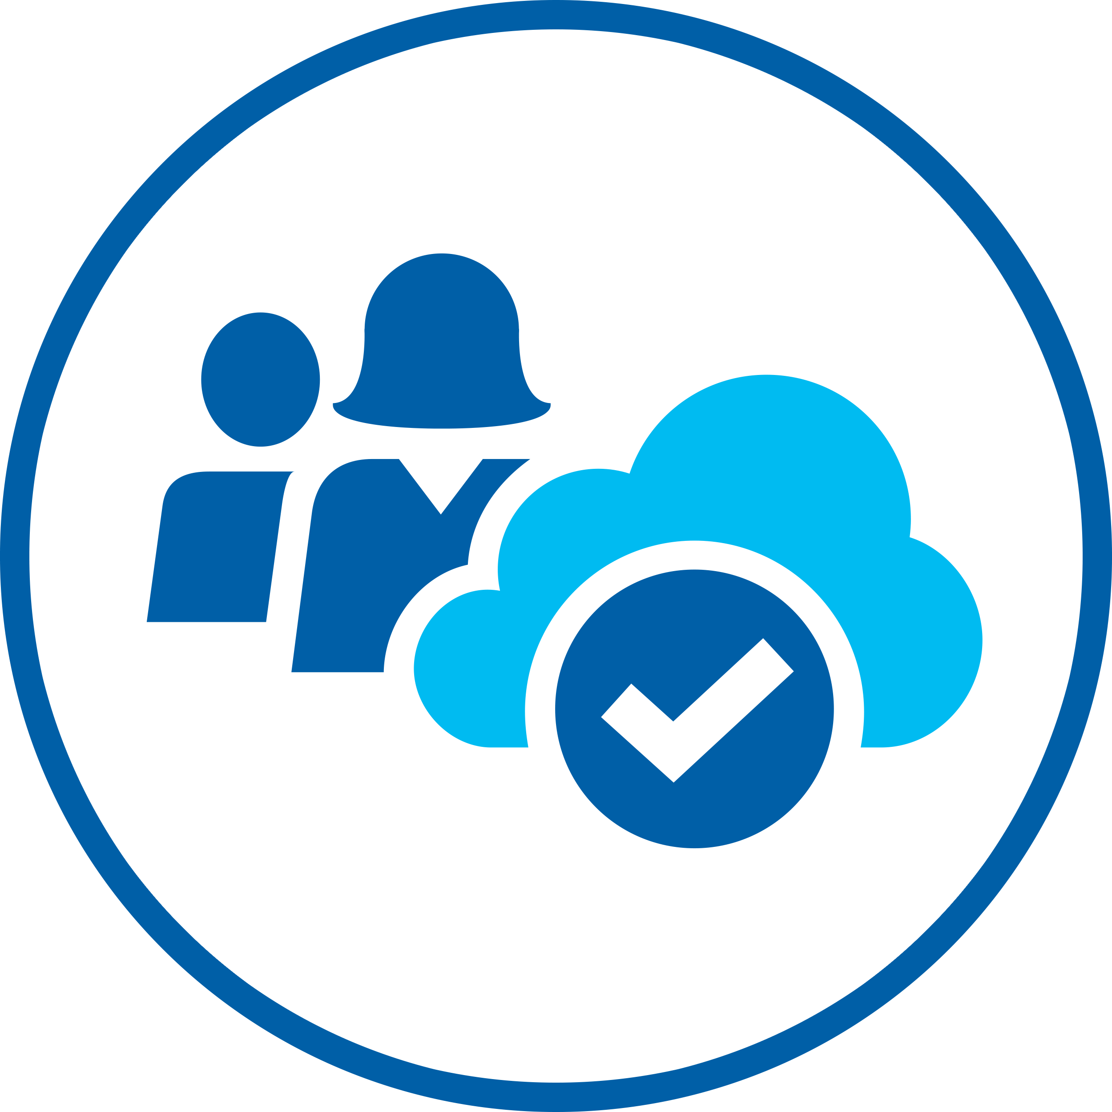
Whiteboard Design Session
Design a solution to integrate with a customer’s existing cloud investments and Dynamics 365.

Slide 15
Long Break
Please return to the session by 12:00pm PT

Slide 16
Team Challenge
Delivering a collaborative Microsoft 365 environment that includes power platform and D365 integrations.

Slide 17
Office Hours

Slide 19
Whiteboard Design Session
Microsoft Cloud Workshop: Modern Cloud Apps
In the whiteboard design session, you will work in groups to design a solution to modernize an e-commerce applications backend and ensure compliance, data privacy and protection across all aspects of the system, in transit and at rest.
The goal is to use Azure PaaS services for the public-facing and back-end websites, while providing a way for the on-premises components to securely communicate with these services. You will also design fault-tolerance and a regional failover plan of the Azure components.
By the end of this whiteboard design session, you will have a better understanding of how to modernize a legacy web app by retargeting it for the cloud, taking advantage of the many services Azure provides to enhance functionality and secure your solution's components by following best practices for PCI compliance and security.
Notes:
https://github.com/Microsoft/MCW-Modern-Cloud-Apps

